Slide 1
SoI Student Project Review
Petition Response Engine
Team : CodeSmiths
Lead : Sarwina M
Members : Sanjana S , Srinivetha S G , Tharchana S , Kamalesh M
SoI Mentor : Mathew Valan D L
SoI Vertical : AD
Cohort/Batch : [2024-2028]

Slide 2
Problem & End User Identification
End User / Customer
Citizens filing grievances
Govt. officials handling petitions
Situation Trigger
High volume of petitions daily
Manual sorting → delays, misrouting, backlog
Evidence
Govt. reports of delays
News on pending grievances
Repetitive issues observed in portals
Success Metrics
Faster processing time
Fewer errors/misclassifications
Duplicate petitions auto-merged
Timely updates to citizens

Slide 3
Problem Description
Petitions are manually read, categorized, and forwarded, making the process slow and error-prone.
Misrouting or overlooking petitions is common due to manual handling.
Large volumes of petitions every week create heavy backlogs.
Duplicate or similar grievances are treated as separate cases, adding to workload.
Citizens rarely get timely status updates, reducing transparency and trust.
Lack of communication leaves petitioners feeling ignored or dissatisfied.
Officials struggle to track progress across multiple departments.
Absence of proper monitoring weakens accountability and oversight.
Urgent or important cases often fail to get prioritized.
Inefficiency and delays reduce citizen satisfaction and public confidence.
Government departments face resource strain, lowering overall productivity.
Limited data analysis makes it hard to identify patterns in common grievances.

Slide 4
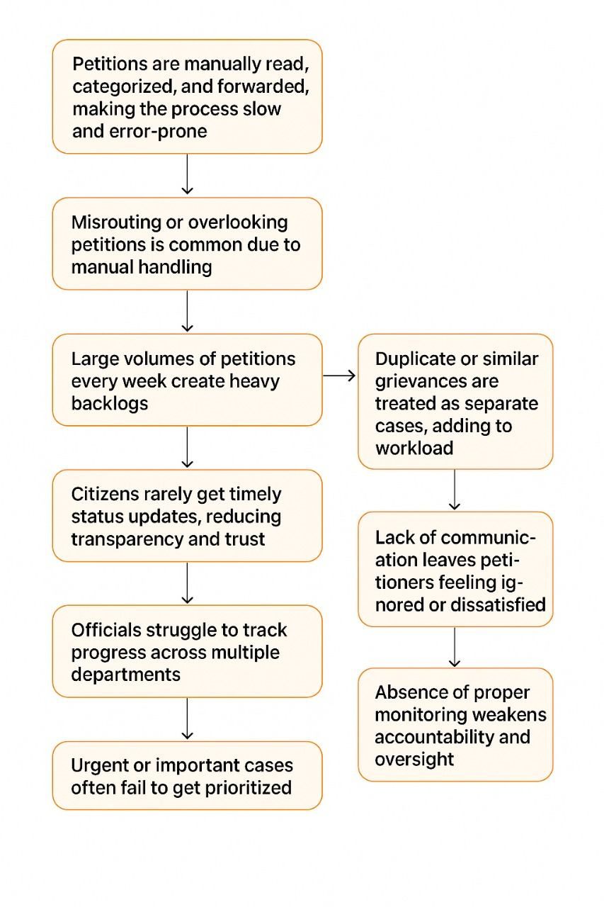

Slide 5
Literature Survey (Research)
Source (APA/IEEE) | Year | Key Insight / Method | Gap Relevant to Our Problem
Noguti, M. Y., Vellasques, E., & Oliveira, L. S.. Legal document classification: An application to law area prediction of petitions to Public Prosecution Service. | 2020 | Classified petitions using Word2Vec + LSTM (~90% accuracy). | No urgency detection, reminders, or petitioner updates.
Malik, V., Sanjay, R., Guha, S. K., Hazarika, A., Nigam, S., Bhattacharya, A., & Modi, S.. Semantic segmentation of legal documents via rhetorical roles. | 2021 | Segmented legal documents into rhetorical roles (facts, rulings, statutes). | Not applied to grievance petitions or urgency detection.
Mahoney, C. J., Zhang, J., Huber-Fliflet, N., Gronvall, P., & Zhao, H.. A framework for explainable text classification in legal document review. | 2019 | Proposed explainable AI framework for legal doc classification. | No workflow tracking or citizen communication.
Kumar, H., Kaushal, R. K., & Kumar, N.. Issues with existing solutions for grievance redressal systems and mitigation approach using blockchain network. In Proc. 2nd (ICADSS) | 2025 | Analyzed problems in grievance systems and proposed blockchain for immutability, accountability, and tracking. | Blockchain improves trust, but does not address AI-driven categorization, urgency detection, or citizen communication.
Hossain, N.. A review of the literature on grievance redress mechanisms in the global South. Policy and Society (Taylor & Francis) | 2024 | Reviewed grievance mechanisms, highlighting delays, lack of transparency, and citizen dissatisfaction. | Review-based; lacks technical AI/ML solutions for categorization, urgency, or progress reminders.

Slide 6
Existing Solutions (Products/Services)
Feature / Criteria | Product A(Legal Doc Classifier) | Product B (Case Mgmt. System) | Product C(Blockchain Grievance) | Our Approach(AI Grievance Tool)
Target User | Lawyers, courts | Govt. departments | Public grievance cells | Citizens, govt. officials, petitioners
Core Function | Classifies petitions by law area | Tracks case progress | Ensures transparency via blockchain | AI categorization, urgency detection, reminders, updates
Accuracy/Performance | ~90% accuracy in classification | Moderate, rule-based tracking | High transparency but no AI intelligence | AI+NLP + ML for high accuracy & prioritization
Cost | High (custom ML models) | Moderate | High infra cost | Scalable & optimized
Deployment | Research/demo tools | Enterprise systems | Pilot stage | Cloud/mobile/web integration
Data/Privacy | Limited privacy safeguards | Basic role-based access | High (immutable ledger) | Secure AI + privacy compliance
Known Limitations | No urgency detection/reminders | Manual categorization, slow | No AI categorization/alerts | Addresses all above gaps, end-to-end workflow

Slide 7
Unique Selling Proposition (USP)
Value Proposition (for citizens & officials): Faster, transparent grievance handling with real-time updates and reduced backlog.
Key Differentiators:
AI-driven categorization & urgency detection
Duplicate grievance identification
Automated reminders for officials
Status communication to citizens
Cross-department progress tracking
Why Now:
Rising petition volumes in Digital India era
Advances in NLP/AI make automation feasible
Strong push for transparent e-governance
Evidence / Early Signals:
Govt. reports highlighting delays & backlogs
Citizen feedback on lack of updates
Pilot studies show AI cuts processing time significantly
Feasibility:
Large petition datasets available
Proven NLP/ML models for text classification
Team skills in AI, cloud, and APIs
Risks (misclassification, data privacy) mitigated via human review + secure infrastructure

Slide 8
Project Plan & Timeline
Phase | Start–End | Milestones/Deliverables | Evidence of Validation
Problem & Customer Validation | 17 Sep 2025 – 25 Sep 2025 | Surveys, interviews with citizens & officials, define pain points | Mentor & customer feedback, requirement report
Ideation (multiple concepts) | 26 Sep 2025 – 10 Oct 2025 | Brainstorm AI workflows, draft architecture, compare tech options | Mentor validation, shortlisted concepts
Proof of Concept (PoC) | 11 Oct 2025 – 31 Oct 2025 | Build small AI model for petition categorization & urgency flag | Metrics: accuracy, F1-score; stakeholder demo
Prototype | 1 Nov 2025 – 25 Nov 2025 | Web dashboard + basic AI categorization + reminder alerts | Usability testing, official feedback
Minimum Viable Product (MVP) | 26 Nov 2025 – 20 Dec 2025 | Full AI pipeline: categorization, urgent case flagging, reminders, progress tracking | Pilot testing with real petitions, mentor feedback
Final Product / Solution | 21 Dec 2025 – 15 Jan 2025 | Complete platform: AI analysis, reminders, transparency dashboard, petitioner status updates | Metrics (accuracy, response time), user adoption, stakeholder sign-off

Slide 9
Risks, Assumptions & Dependencies
Key Risks Assumptions
Limited access to petition data > Citizens & officials will use the tool
Privacy & compliance concerns > APIs/datasets are available
NLP accuracy for classification > Adequate budget & infrastructure
Dependencies Mitigation Plan
Govt. departments & grievance portals > Secure data agreements & anonymization
NLP/AI tools & cloud services > Training & awareness for officials
Communication APIs (SMS/email) > Human-in-loop review for AI errors

Slide 10
References
1. Noguti et al., 2020
Title: Legal Document Classification: An Application to Law Area Prediction of Petitions to Public Prosecution Service
Authors: M. Y. Noguti, E. Vellasques, L. S. Oliveira
Link: https://arxiv.org/abs/2010.12533
Summary: Used Word2Vec + LSTM for classifying legal petitions into law areas with ~90% accuracy. Lacks urgency detection and grievance tracking.
2. Malik et al., 2022
Title: Semantic Segmentation of Legal Documents via Rhetorical Roles
Authors: V. Malik, R. Sanjay, S. K. Guha, A. Hazarika, S. K. Nigam, A. Bhattacharya, A. Modi
Link: https://aclanthology.org/2022.nllp-1.13
Summary: Proposed segmentation of legal texts by rhetorical role to improve AI comprehension. Does not address petition prioritization or reminders.
3. Nigam et al., 2025
Title: LegalSeg: Unlocking the Structure of Indian Legal Judgments Through Rhetorical Role Classification
Authors: S. K. Nigam, T. Dubey, G. Sharma, N. Shallum, K. Ghosh, A. Bhattacharya
Link: https://arxiv.org/abs/2502.05836
Summary: Developed LegalSeg for Indian judgments using rhetorical role classification. Focused on judgments, not citizen petitions.

